Slide 1
Humanities 101: Week 2
Pre-history and the Birth of Civilization
Mesopotamia: Gods, Rulers and the Social Order

Slide 2
Paleolithic “Old Stone” Culture (ca. 7 million-10,000 B.C.E.)
Our planet is approximately 4.5 billion years old
Between 10 and 5 million years ago our ancestral humans first walked the earth
Molecular biology indicates that DNA of chimpanzees is 99% identical to humans
Hominids- near human or proto-humans appeared in Africa some 5 million years ago. Hominids lived in packs and were primarily hunter- gatherers.
The Paleolithic Era has three periods:
  Lower Paleolithic (25 million to 200,000 years ago) Homo Sapiens
  Middle Paleolithic (200,000 to 40,000 years ago) First Cave Paintings
  Upper Paleolithic (40,000 to 10,000 years ago) Religious Expression and Rituals

Slide 3
Various Human Like Species
Homo habilis – “Tool-making human” – created the first stone and bone tools and weapons
Homo erectus- “Upright human” Co-existed with homo habilis for a half a million years, but made tools that were more varied and efficient than their predecessors
Neanderthals- From our film, appeared in the Neander Valley near Dusseldorf, Germany. They are named for this site where the first specimens were discovered in 1856.

Slide 4
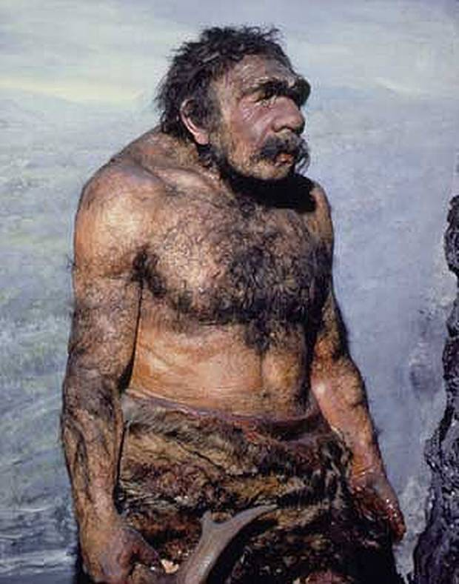
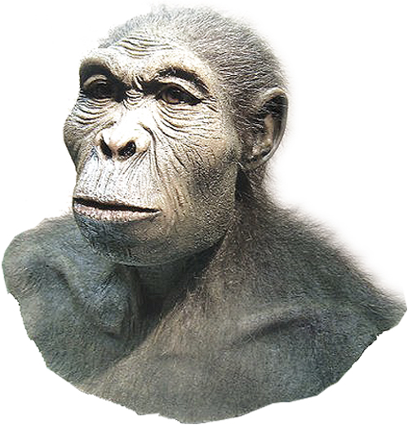
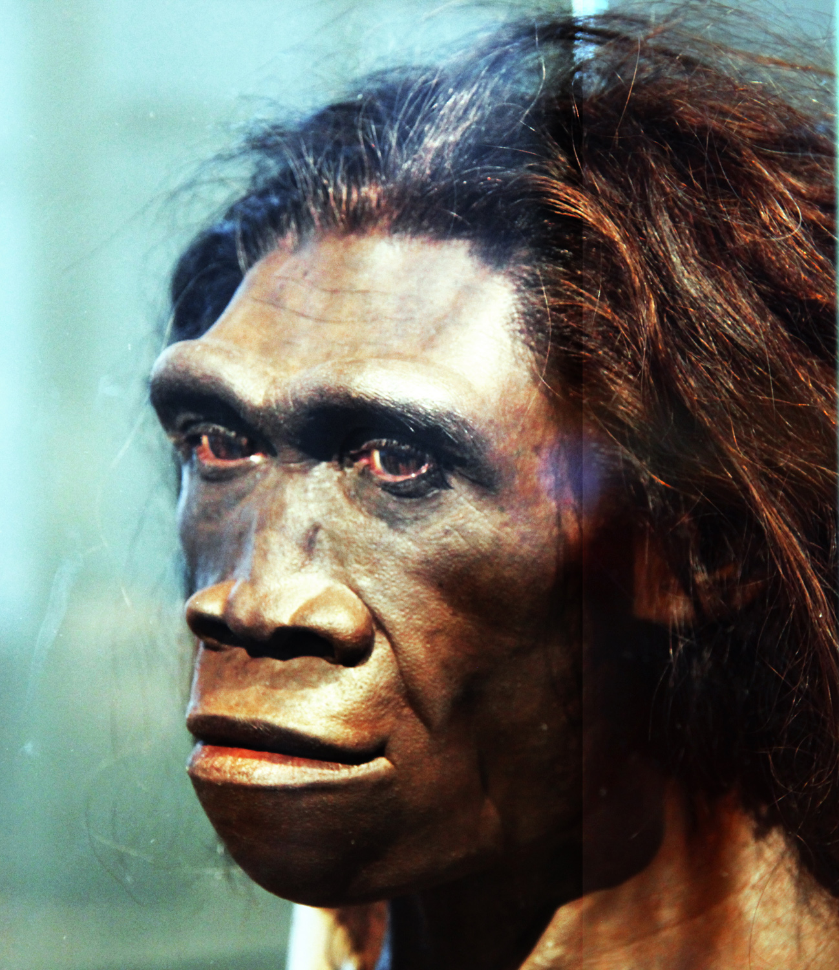
Homo habilis
Homo Erectus
Neanderthal

Slide 5



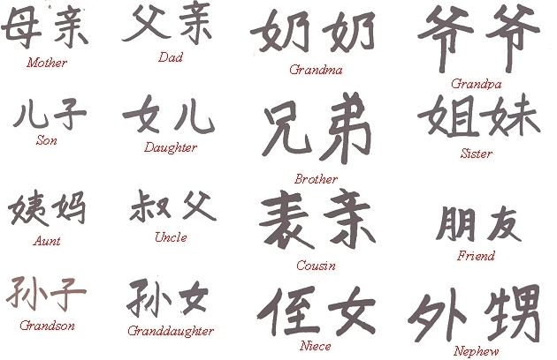
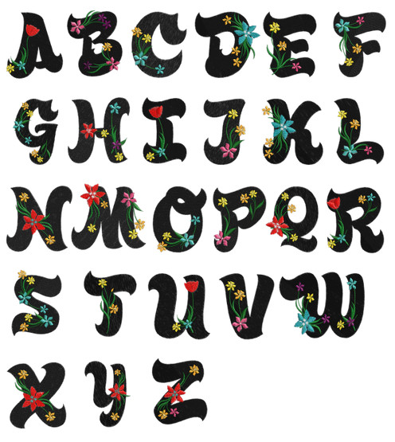

What makes a Homo Sapien?

Slide 6
Homo Sapiens
New science questions whether Homo sapiens were the first to use language
Larger brains
Complex motor abilities
Produced symbol systems that enabled them to transmit ideas and inventions
Although nearly fifteen human like species co-existed with Homo sapiens, they were the only to survive. Extinction? In breeding?

Slide 7
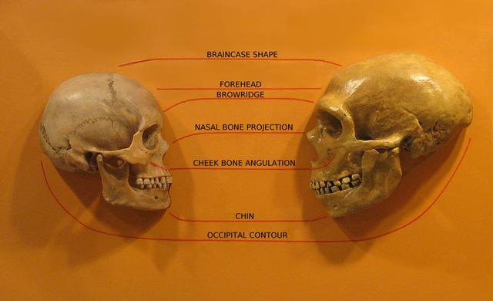

Slide 8

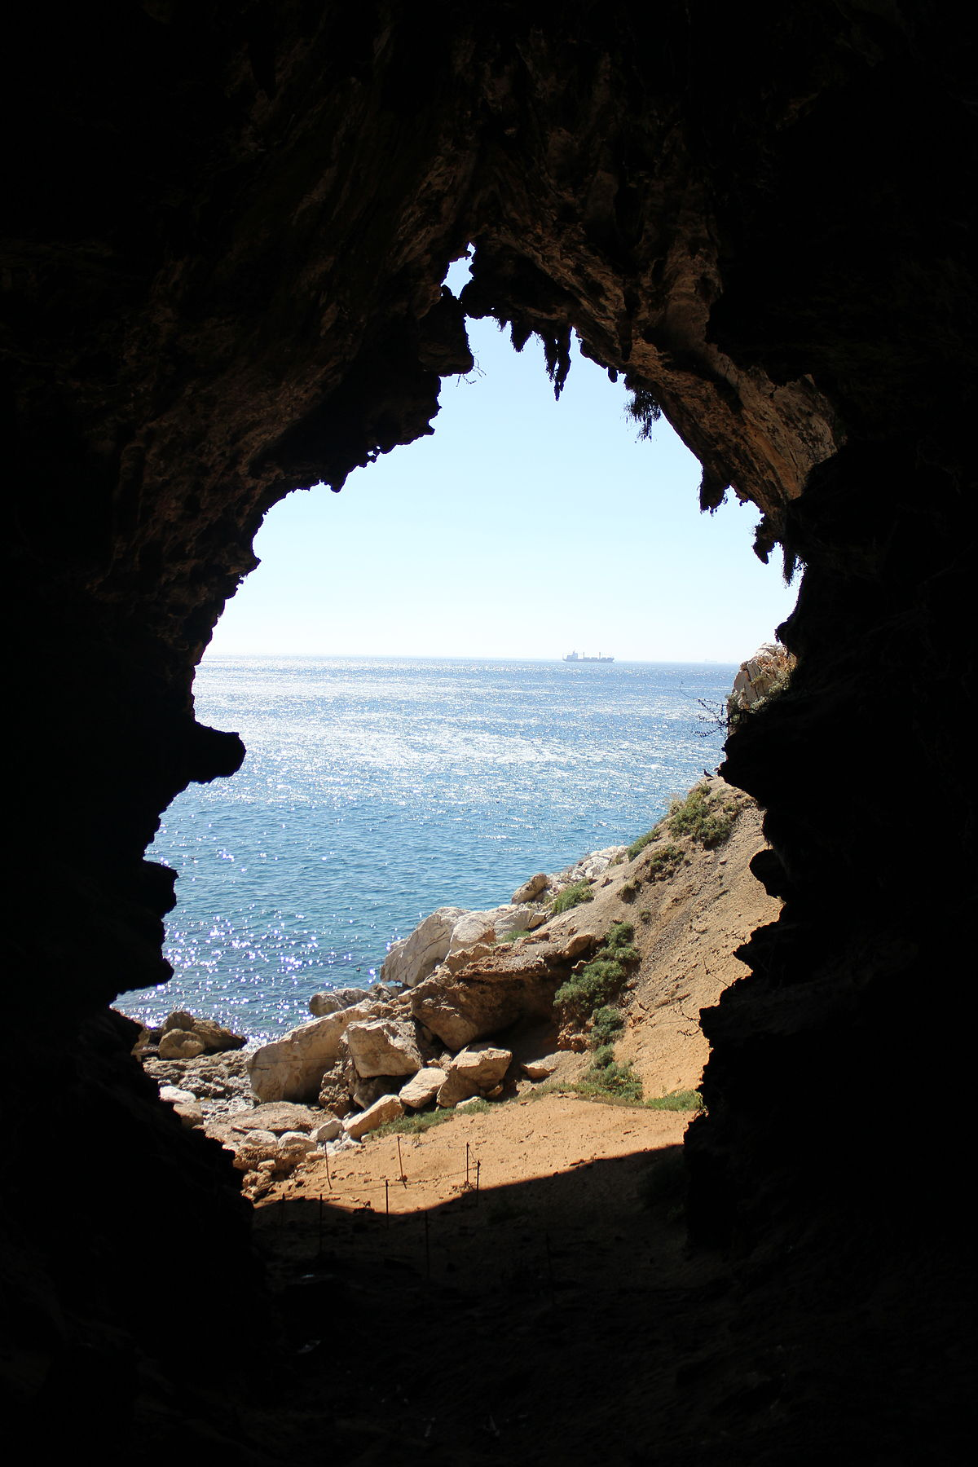
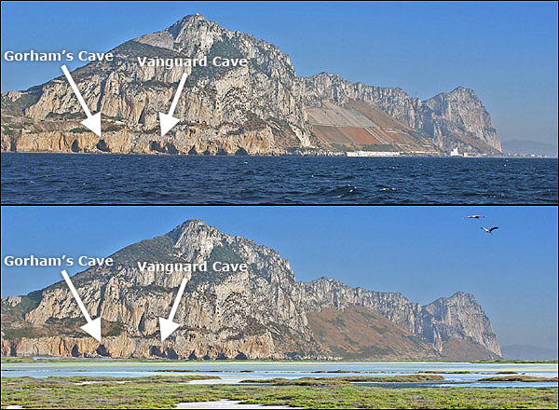
Gorham’s Cave, Gibraltar

Slide 9
Studying Art from Any Age
ART DOCUMENTS THE RISE AND FALL OF CIVILIZATIONS
Iconography- as a branch of art history, studies the identification, description, and the interpretation of the content of images: the subjects depicted, the particular compositions and details used to do so, and other elements that are distinct from artistic style.
  It, the medium, the text leads us to
    Context
    Subtext
    These interpretations, often the subject of scholarly study, are the basis for SECONDARY SOURCES (suppositions or conclusions drawn from primary source evidence)

Slide 10
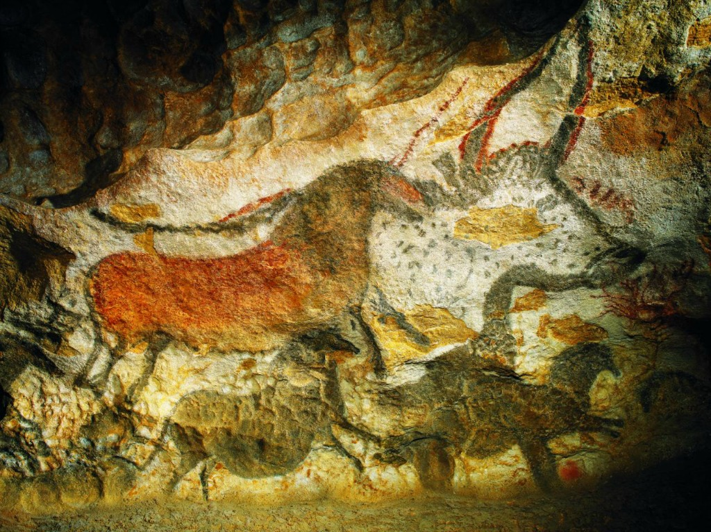
CAVE ART

Slide 11
Early Cave Art:
The most famous cave art is found in Southern France, in places like Lascaux, the Vezere Valley, and the Volp Caves in the Pyrenees. The majority of these paintings date from about 30,000 years ago, however, a few excavated pieces can be dated back to 41,000 years ago.
Skillfully painted using polychrome mineral pigments, the majority of these studied paintings are strongly naturalistic, depicting animals, hunting rituals, and devices for seasonal and lunar change. Some scholars argue that because of the similarity in some of these paintings, which are found all over the world, that this art may have been some sort of communication device.
These caves were not dwelling places, they were unfit for habitation. This art was painted there because it was considered “other-worldly,” a sacred space. Arriving at these scenes was a perilous journey, not for the faint of heart.
This is the first example of LEGACY in the art of a civilization; a group of people needing to leave their mark for future generations.

Slide 12
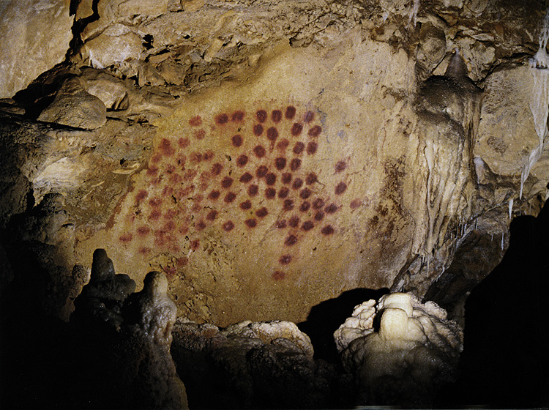
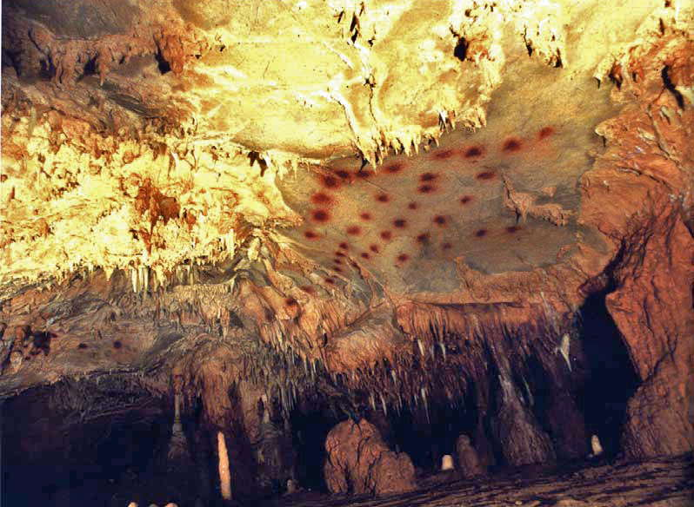
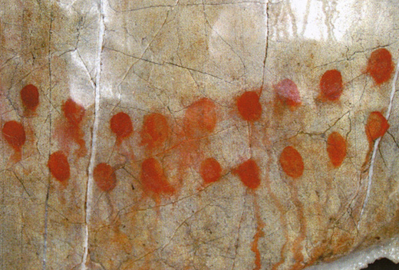
Les Trois Freres, France
The earliest known surviving cave art, show paths marked by random patterns of black and red dots.
Scholars have been debating whether these dots are recordings of spirits or visions, symbols for the male and female, or a possible form of communication or code.

Slide 13
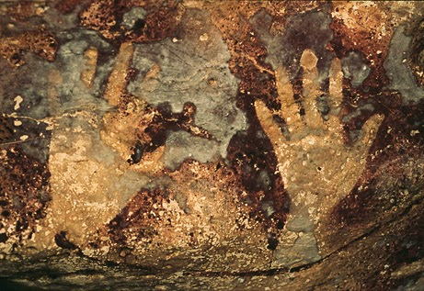
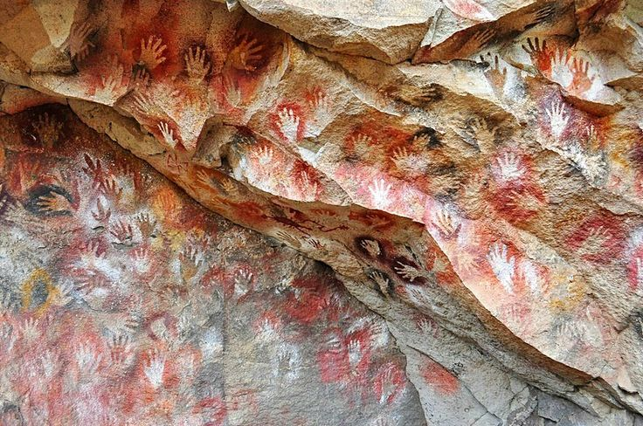
PERU
BORNEO
These handprints, dipped in pigment then applied to the wall, or negatively applied by spraying paint around the hand, are found all over the world, in places like Europe, Asia, Australia, Borneo, Peru, Mexico, the Sahara, and Argentina. The red ochre paint used was considered a bridge between the material and spiritual worlds.
The handprints were never left in easy to reach places, instead archeologists have found them on ceilings, between stalactites, and in tight crevasses. Mostly comprised of small hands, this is intriguing because early man rituals were thought to be primarily male dominated.
Scholars believe these handprints were possibly primitive sign language, or some form of communication, due to the discovery of the handprints, and the same method, utilized in so many places all over the world.

Slide 14
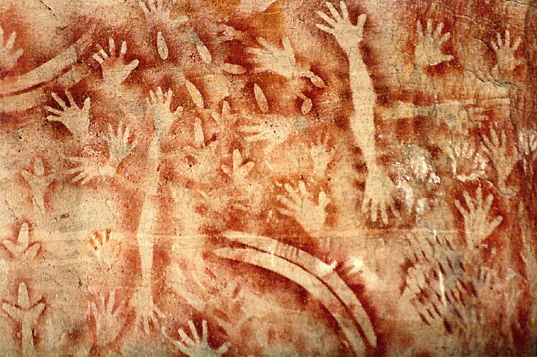
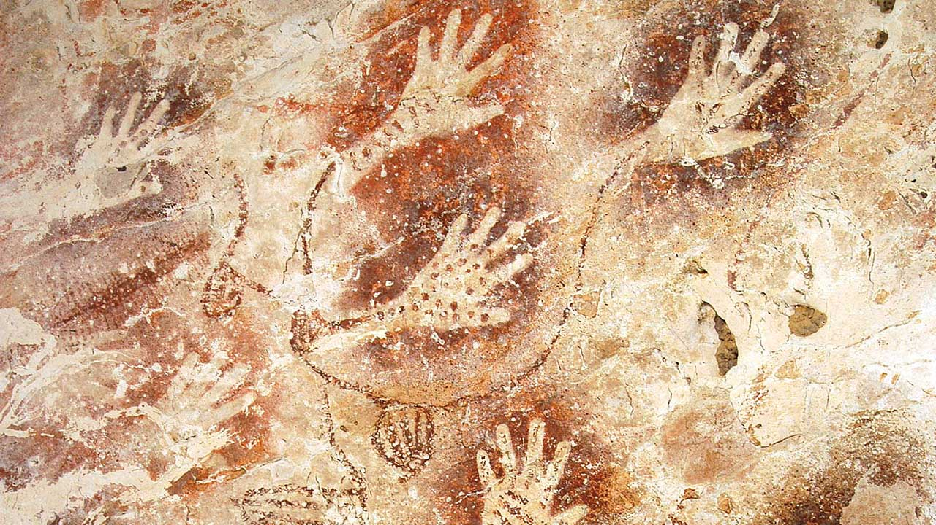
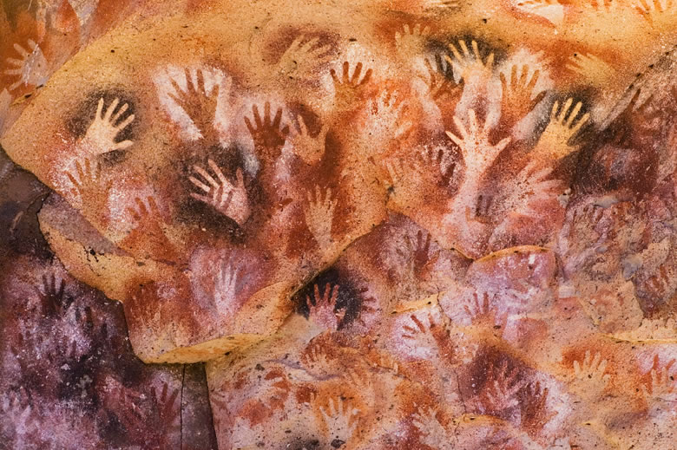
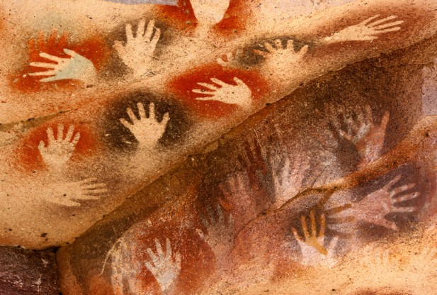
AUSTRALIA
MEXICO
ARGENTINA
ASIA

Slide 15
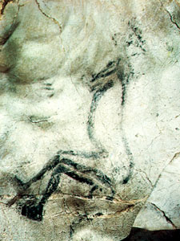
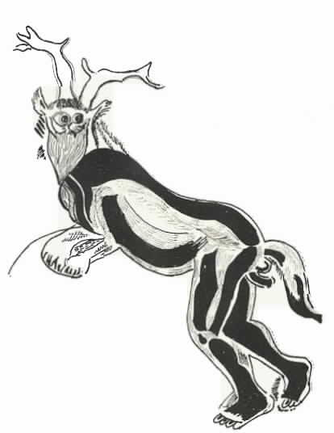
In Les Trios Freres in France, “The Sorcerer” or “Lord of Beasts” stands 25 feet tall and high above eye level. He is a man-beast, first thought to be a man in an animal costume.
The Lord of Beasts is an ancient deity, the master of animals, and the ruler and guardian of the forests. He is prayed to for guidance for the hunter, is placated by sacrifices, and collects the souls of all animals after they are killed.
Some version of this deity exists all over the ancient world, and some scholars believe that this painting is the earliest image of God ever found.

Slide 16
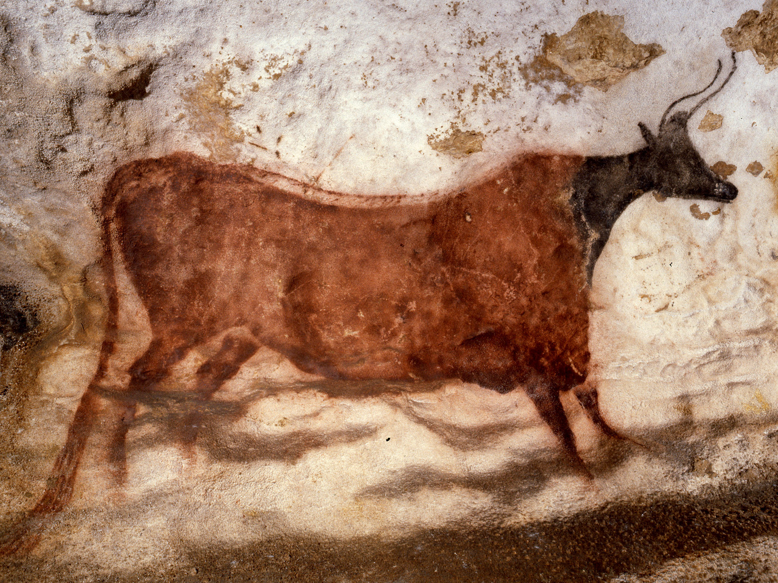
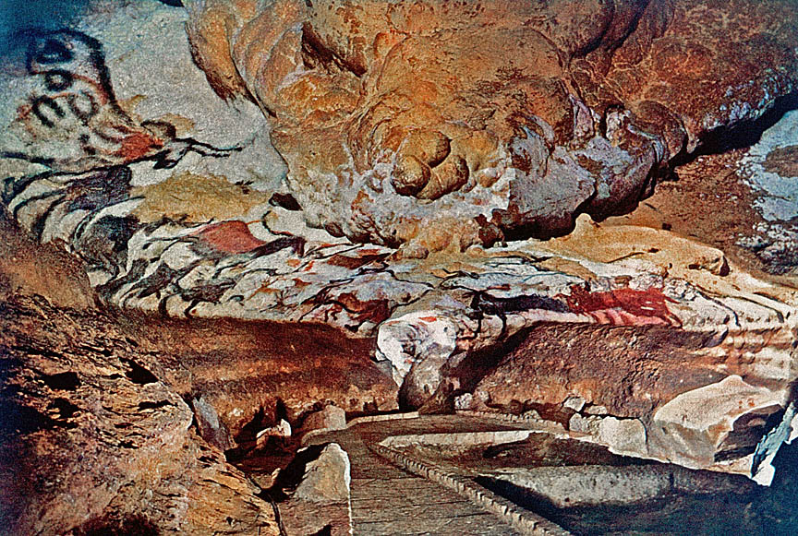
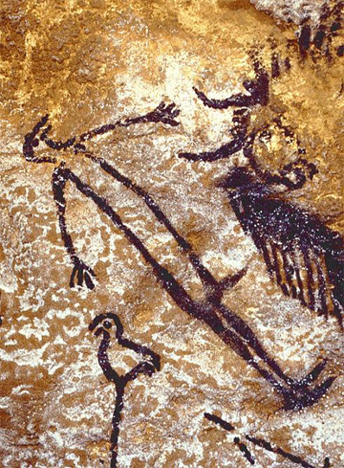
Lascaux Cave Art
Southern France

Slide 17
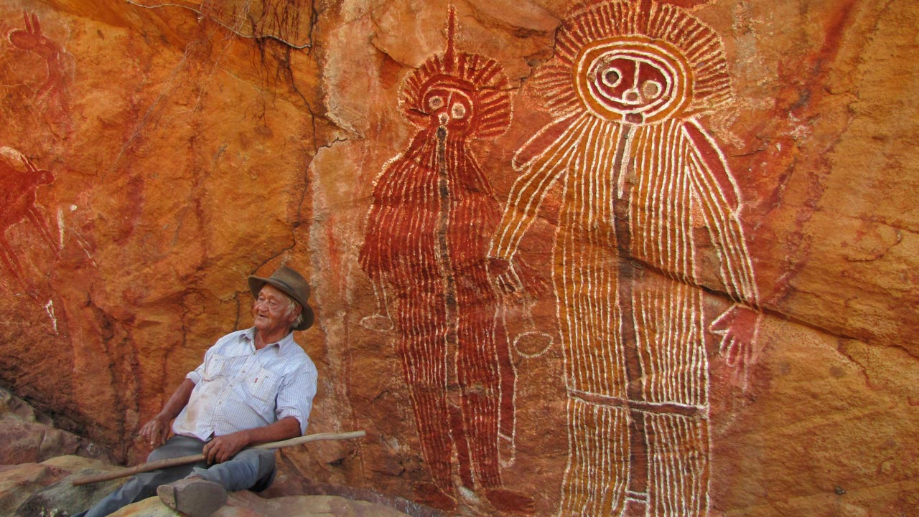

Slide 18
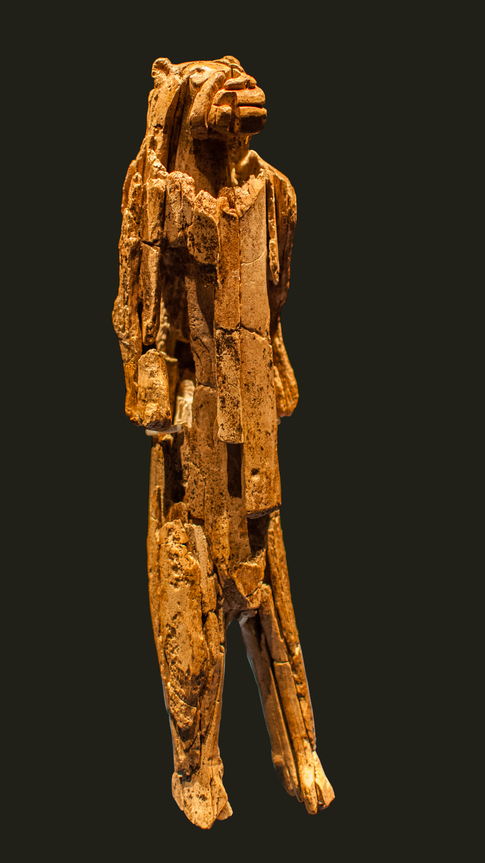
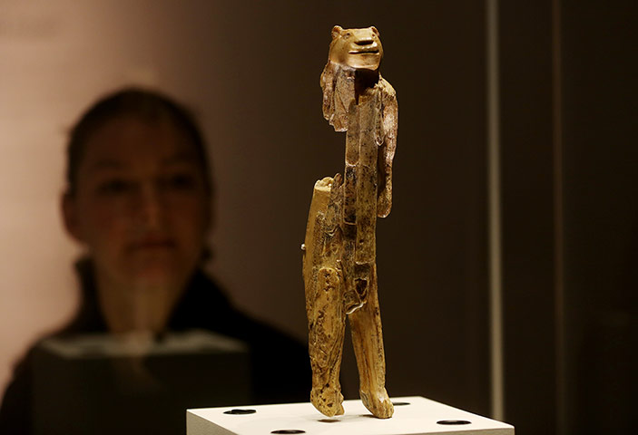
The “Lion-Man” Sculpture:
Discovered in a cave in Southern Germany in 1939, and carved out of ivory, this piece is the oldest known zoomorphic sculpture in the world and the first example of figurative art known to man.
Carbon dating place the age of this piece at 35,000-40,000 years ago, and it was rebuilt from over 200 fragments.
The “Lion-Man” was carved over 100’s of hours giving archeologists proof that specialized artisans existed in early civilizations. Why?

Slide 19
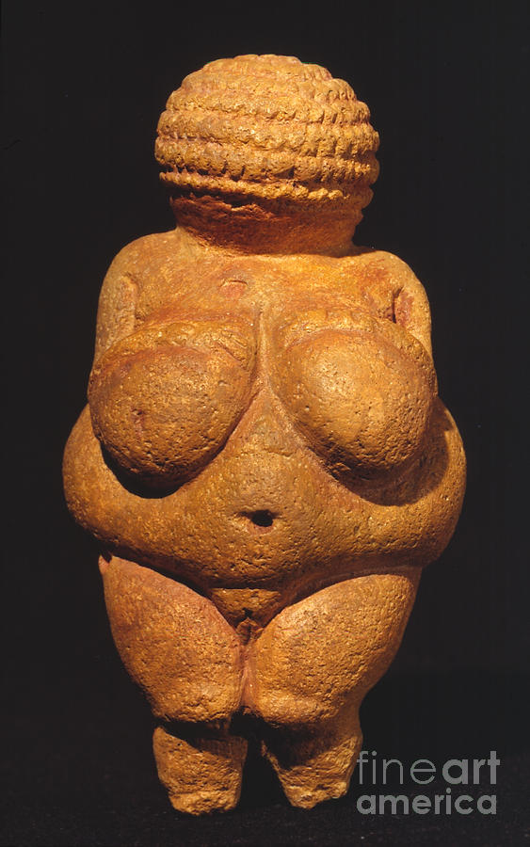
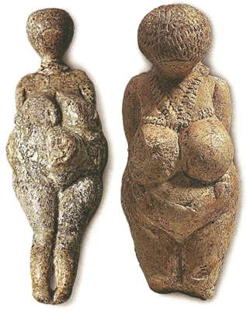
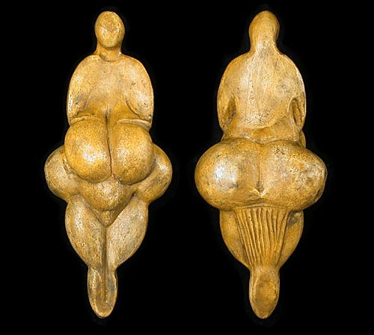
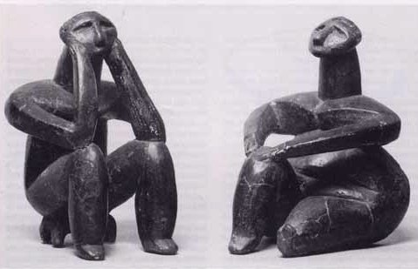
Representation of Woman in Pre-History Art
Lespugue Venus
Venus of Willendorf
The Kostionki Venus

Slide 20
Mother Earth the original “Earth Mamas”
Women secured food and acted as healers and nurturers
Assured the continuity of the tribe, where female role was very important
Mysterious powers of procreation, female cycles connected to moon’s cycles
Represents the origin of Realistic art, most famously credited to The Greeks.
More than a hundred of these statuettes have been found at sites ranging from France to Russia, most represented as naked, well-rounded women with no distinguishable facial features.

Slide 21
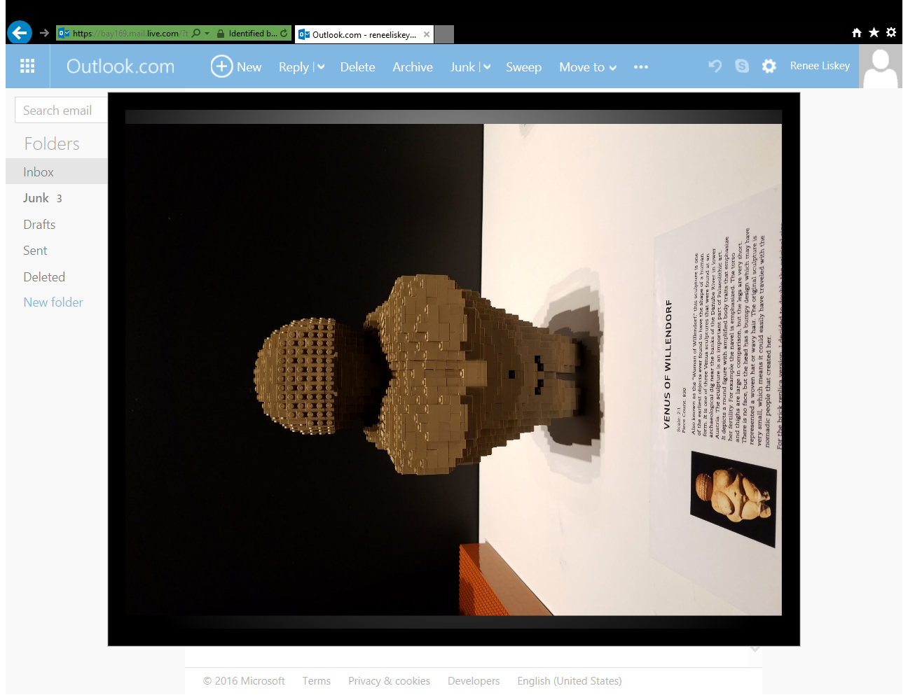
Venus of Willendorf
From the Lego art installation “The Art of the Brick”
Nathan Sawaya

Slide 22
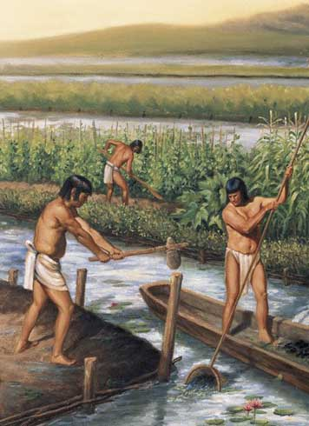
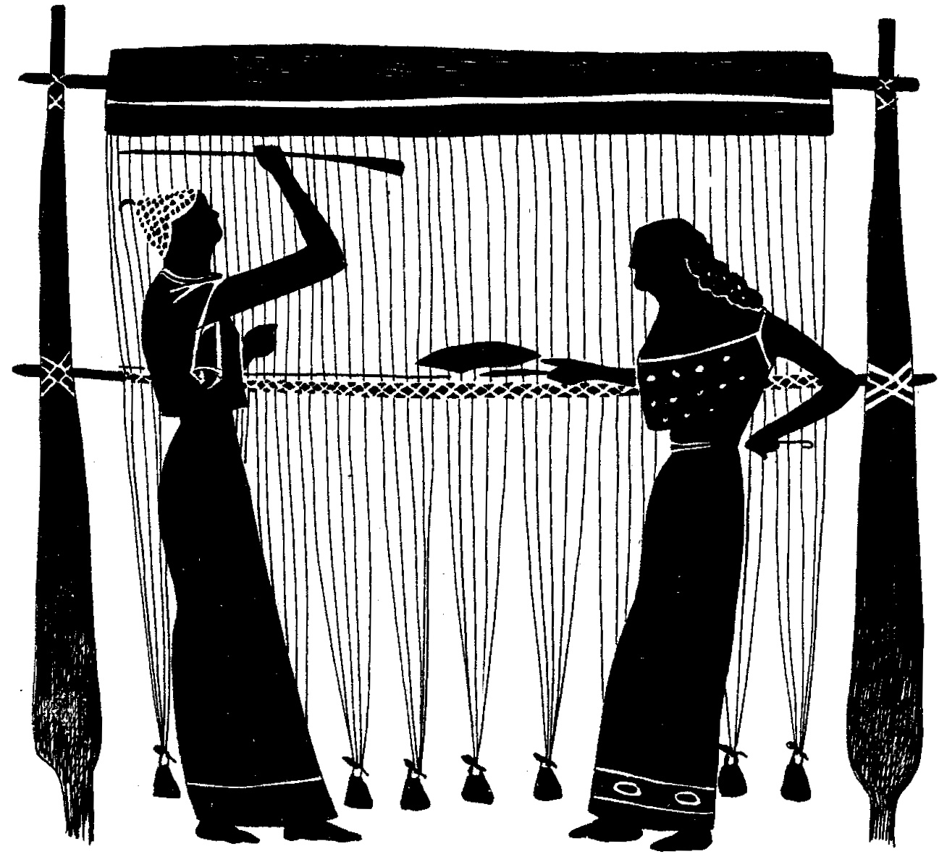
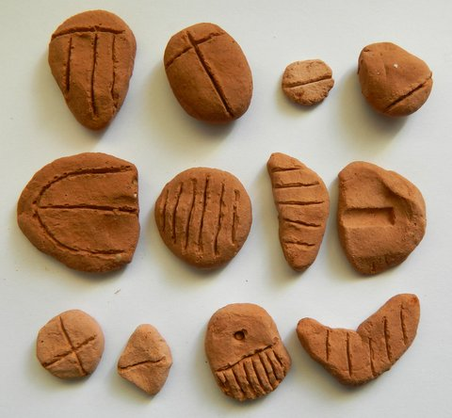
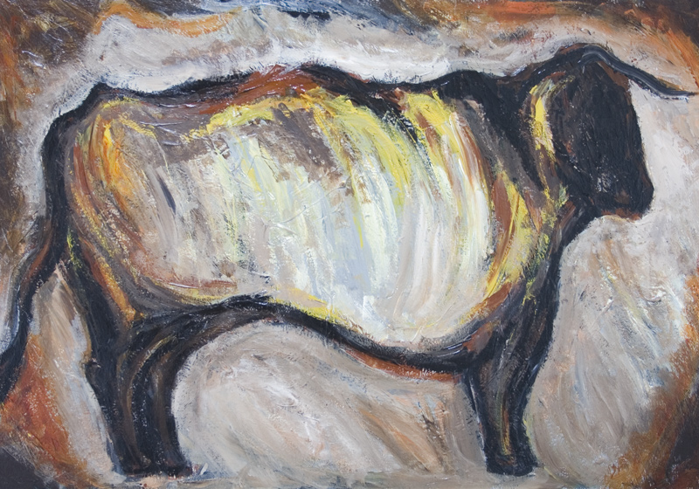
Neolithic “New Stone” Culture
(ca. 8000-4000 B.C.E.)
Food production (cultivation) begins
Cattle is domesticated, herding begins 10,000 B.C.E
Clay tokens are used in Mesopotamia to tally goods 8000 B.C.E.
Cloth is woven 7000 B.C.E.
Crop irrigation is first employed 5000 B.C.E.

Slide 23
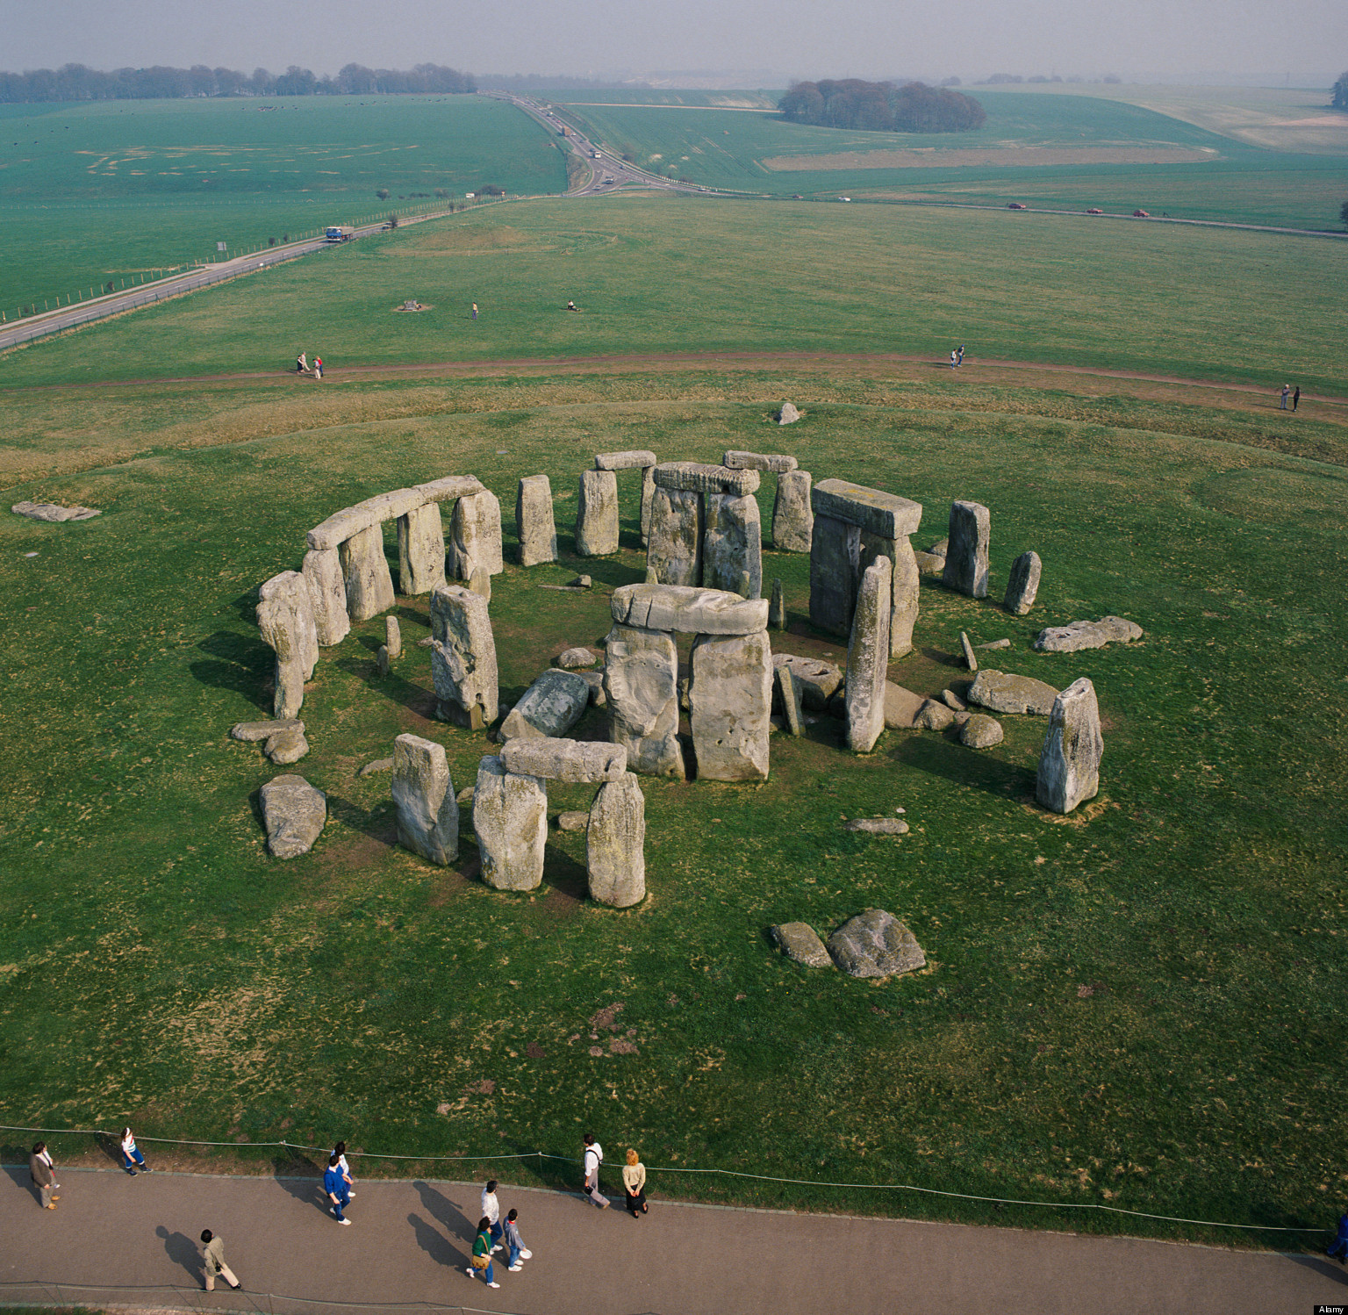
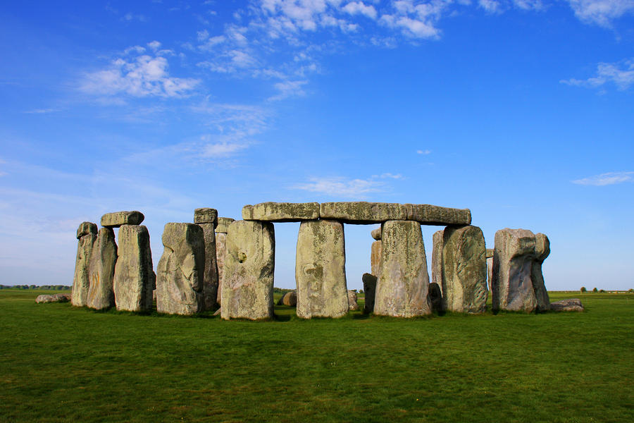

Slide 24
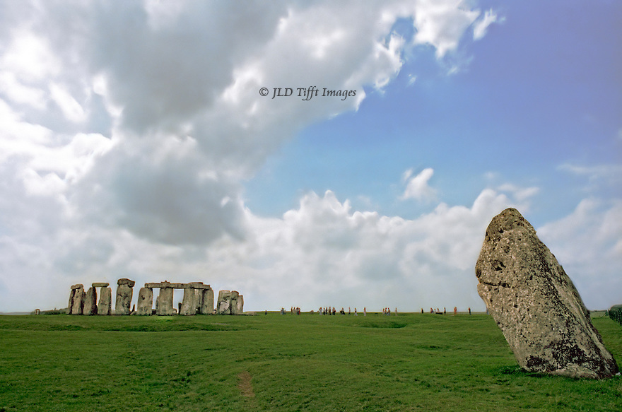
Stonehenge with Heel stone in foreground

Slide 25
Neolithic Art and Architecture
Most famously- STONEHENGE
  Formed over 2000 years- Stonehenge forms one of the most mysterious and impressive ritual spaces of the prehistoric world
  Megaliths- “Great Stones” to mark a grave or ritualistic space, for Stonehenge, some were 25 to 50 tons!
  Post-and-lintel construction forming inner and outer circles
  35- Ton stele, known as the Heel Stone stands apart from the complex, marking the point at which the sun rises at the summer solstice
  Served as a celestial calendar, but also possibly as a site for funerary rituals
  How exactly this structure was erected is unknown, but the complex must have demanded a huge investment in time and labor, implying a highly centralized society.

Slide 26
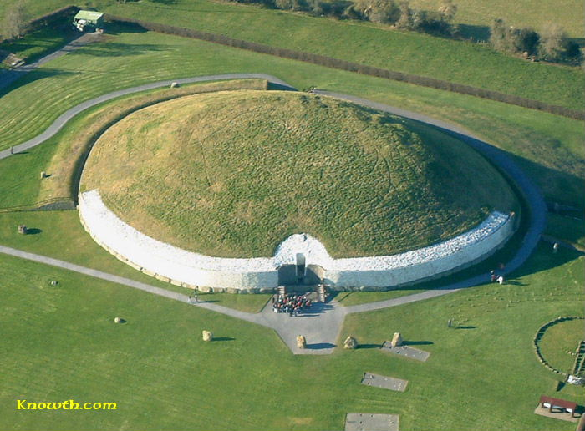
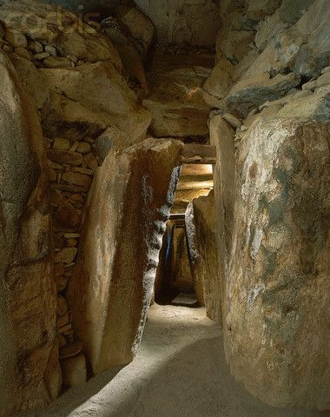
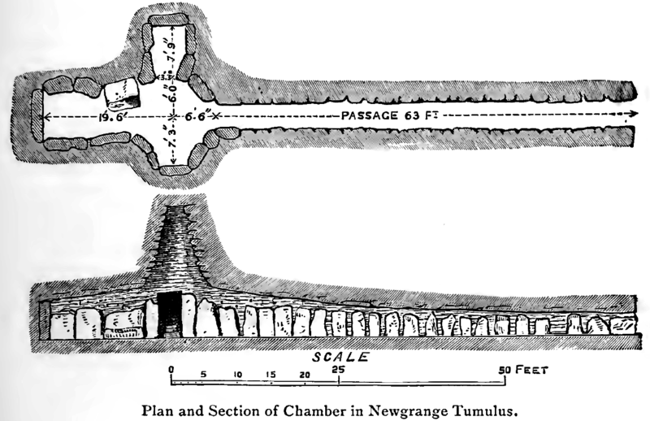
Newgrange, Ireland

Slide 27
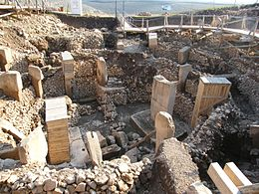
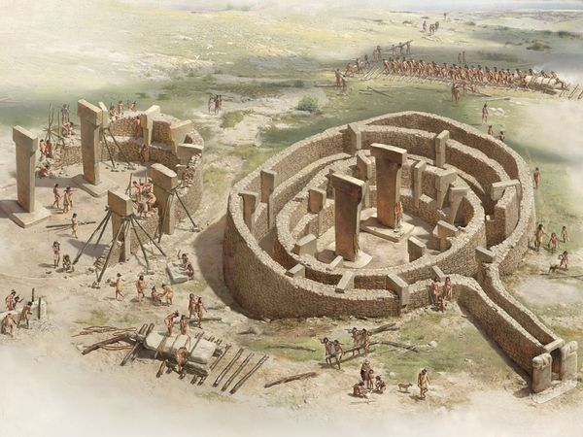
This structure is called Gobekli Tepe, which is situated on a mountain ridge in southeastern Turkey, a city that was once the ancient city of Urfa. What makes this temple special is that it is widely believed that the remains of the Garden of Eden lie buried beneath it.
This temple is comprised of twenty or more large enclosures built of mortar and stone, and is recognized as the earliest religious temple ever built, stretching 1000 feet long and 1000 feet wide.
The two center pillars are engraved with images of ferocious beats and lethal creatures, alongside intricately wrought geometric figures and abstract symbols. The prevailing theory is that they represent a kind of symbolic language, similar to hieroglyphs; however, we have not yet been able to decipher them.
What makes this temple extraordinary is that it was built at the end of the last Ice Age…at least 6,000 years before Stonehenge, and 7,000 years before the Egyptian pyramids. It predates agriculture, which means it was made by semi-nomadic Stone Age hunter-gatherers, who had yet to invent the wheel.

Slide 28
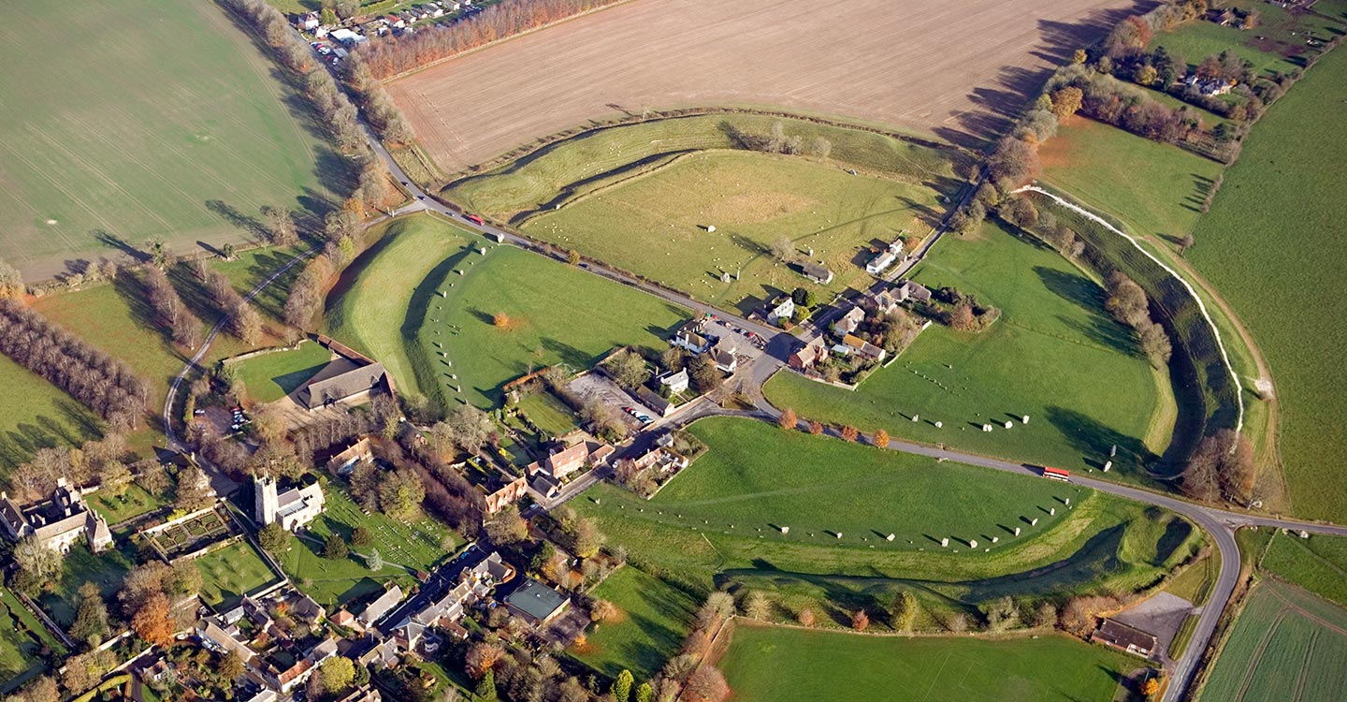
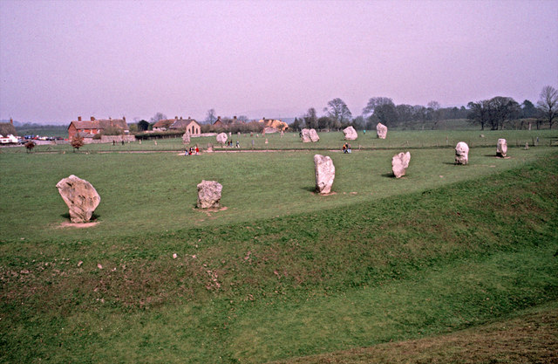
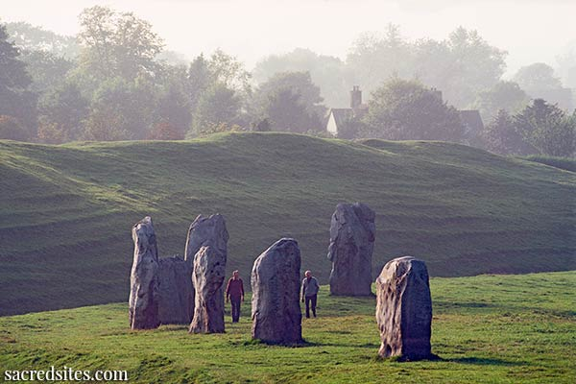
The Circle at Avebury, England

Slide 29
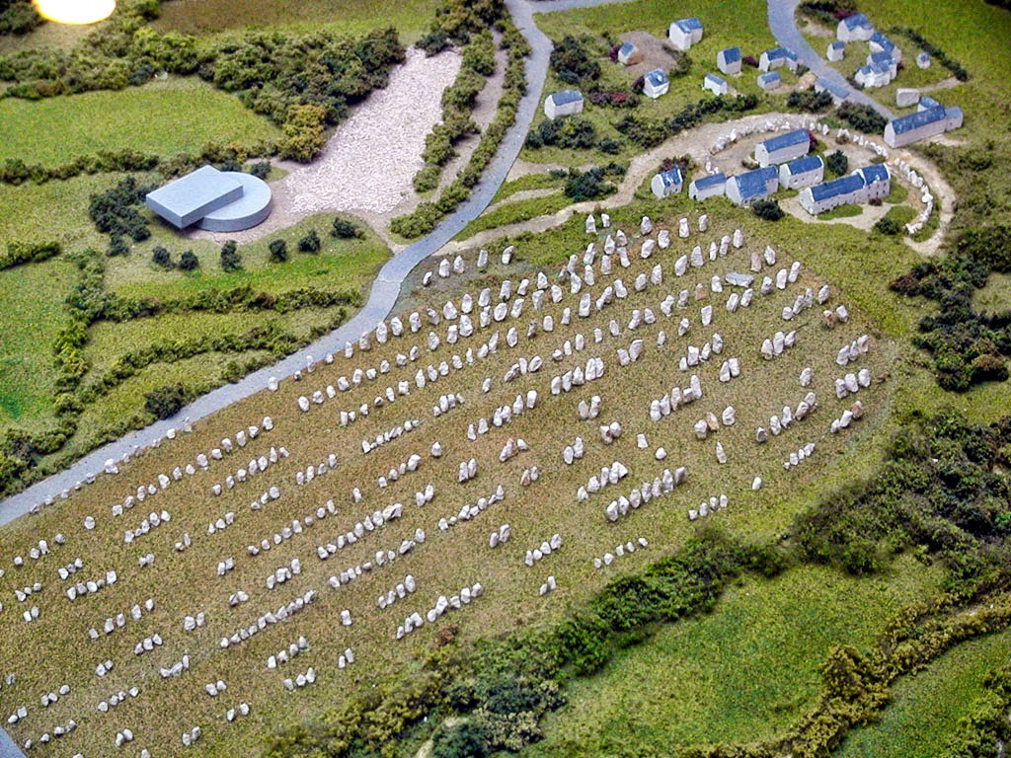
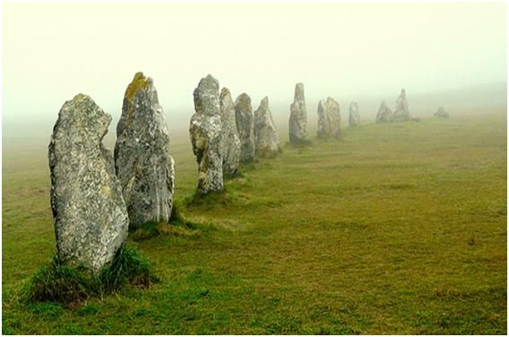
Carnac, France

Slide 30
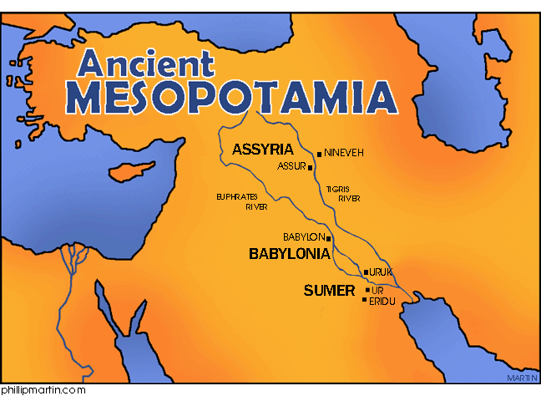

Slide 31
What changes in religion and ritual are brought about by the shift of focus from hunting to agriculture?

Slide 32
Mastery over space vs mastery over time
Mystical solidarity focus changes
Patriarchal to Matriarchal

Slide 33
Mesopotamia 3500 B.C.E.
The first civilization was established in the fertile area between Tigris and Euphrates Rivers (modern day Iraq)
About a dozen cities developed collectively known as Sumeria.
These were self-ruling city-states, capital changed depending on where the power lied.
Evolution of writing
  Pictographs (pictorial symbols), ideograms (a sign that represents an idea or thing)
  Cuneiform (wedge shaped writing) used for over 3000 years ushered in the world’s first Information Age
Polytheistic- worshipped many gods (nearly 3000), unlike the nomadic, monotheistic Hebrews
The ziggurat- a massive terraced tower made of rubble and brick- was the spiritual center of the Mesopotamian city-state. Serving as both a shrine and a temple, and also possibly a burial site, it symbolized the sacred mountain that linked the realms of heaven and earth. These were solid structures, completely filled in, layered in receding stories, like staircases that the gods could use to move back and forth between heaven and earth.
Principal Mesopotamian Gods:
Adad (Storm and Rain), Anu (Father- god of heaven), Apsu (Primeval sweet waters), Dumuzi (vegetation, fertility and underworld), Ea (Wisdom and the arts), Enlil (Earth, wind and air), Ishtar (Queen of Heaven), Ninhursag (Mother goddess, vegetation, Nisaba (goddess of grain), Shamash (Sun, judge and law-giver, wisdom), Sin or Nann (goddess of the moon)

Slide 34
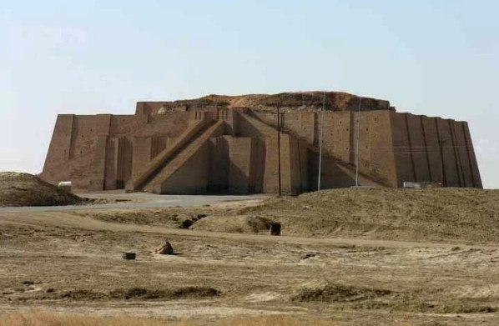
Ziggurat at Ur, in modern day Iraq ca. 2150-2050 B.C.E.

Slide 35



Ancient Mesopotamian Dwellings

Slide 36
How Writing Began:
More than any other achievement, the invention of writing brought a new sense of sophistication to the lives of men. It made it possible to preserve thoughts and experiences, and to hand down wisdom to future generations.
The first written words were pictographs used by the Sumerians to keep inventories. As time went on, scribes refined the crude symbols into complex script capable of expressing abstract ideas, employing over 700 different signs. This new writing form was known as cuneiform.
The final step in the development of cuneiform occurred when scribes began using symbols phonetically, to indicate sounds as well as ideas. The use of phonetic symbols gave writing such flexibility that the later Akkadians, Babylonians, and Assyrians were able to adapt cuneiform to inscribe their own quite different tongues.
As writing grew more and more versatile, it could be used to develop a whole literature of religious, historical, and technical documents, comprising millions of tablets. Added to inventories were astronomical tables, law codes, medical texts, and literary chronicles.
Writing ceremonial and magical qualities as well. Tablets were addressed to gods and placed into the foundations of temples and palaces, as well as utilized as engraved amulets to ward off evil spirits.

Slide 37



Slide 38
The Wisdom of Mesopotamia:
“Who possesses much silver may be happy; who possesses much barley may be glad; but he who has nothing at all may sleep.”
“Writing is the mother of eloquence and the father of artists.”
“Pay heed to the word of your mother as though it were the word of a god.”
“A sweet word is everybody’s friend.”
“Friendship lasts a day, kingship forever.”
“For a man’s pleasure there is marriage; on thinking it over, there is divorce.”
“Conceiving is nice; pregnancy is irksome.”
“The wife is a man’s future; the son is a man’s refuge; the daughter is a man’s salvation; the daughter-in-law is a man’s devil.
“if you take the field of an enemy, the enemy will come and take your field.”
“Who builds like a lord, lives like a slave; who builds like a slave, lives like a lord.”
Be gentle to your enemy as to an old oven.”
“Flatter a young man, he’ll give you anything; throw a scrap to a dog, he’ll wag his tail.”

Slide 39








Mesopotamian Gods- Why do the ancients rely on them?
Adad-God of Storm
Anu-Father of Heaven
Dumuzi- God of Fertility
Enlil- God of Earth, Fire, Air
Ishtar-Queen of Heaven
Ninhursag- Mother Goddess
Nisaba- Goddess of Grain
Shamash- God of Law and Wisdom

Slide 40


Mesopotamian Style

Slide 41
  Creation Myths and Mysticism
  Myths were not as we think of them today (fiction or half-truths)- they reflected the collective beliefs of a society!
Ancient cultures (like modern cultures) needed a way to explain the age old questions- Who are we? Where did we come from? What happens when we die? Similar to most creation myths is the idea of energy and light spreading out infinitely and illuminating the darkness.
Mesopotamians- Earth consists of a large flat circle, with a dome of Heaven connecting the perimeters, and shadowy hell below and on all sides.
The Babylonian Creation (Enuma Elish) – the earliest creation myth
  A Sumerian poem recorded in the second millennium B.C.E., it celebrates the birth of the gods and the order of creation.
  In this creation story, the cosmos was thought to be the end product of a war between the gods, and the cosmos was in fact one of the defeated gods-the goddess Tiamat, a dragon-like creature, think Ursula from The Little Mermaid.
  The hero-god Marduk, offers to fight and conquer Tiamat in exchange for ultimate ruler ship, and this victory enforces the switch of a female dominated ideal to the patriarchal idea of the manly ruler.
  After defeating Tiamat, Marduk founds the holy city of Babylon, and creates human beings.
  What story is commonly referred to as OUR creation myth/story?

Slide 42
  Search for immortality manifests itself in Epic of Gilgamesh
    Epic= a long narrative poem that recounts heroic deeds in quest of meaning and identity, embodies the ideals and values of the culture from which it comes.
    Gilgamesh was recited orally by several different nomadic tribes for centuries before being recorded, giving the story different influences as it developed. It precedes the Hebrew Bible.
    It recounts the story of the King of Uruk, who is two-thirds god and one-third man, and a Babylonian demi-god named Gilgamesh. After nobles complain to the king about Gilgamesh’s harmful actions to the city, Gilgamesh’s mother, the goddess Aruru creates a companion for him named Enkidu. The two embark on fantastic adventures, including the slaying of a bull sent by an angry goddess Ishtar. The gods, angered after Ishtar’s bull is killed, sentence Enkidu to die. Gilgamesh is faced with the death of a loved one and leaves on a journey to find the secret to immortality. Upon finding Utnapishtim, the one human being who has acquired immortality, he learns the story of the Great Flood, and where to find the source of immortality. He inevitably loses the source (a plant), and returns home to live out his years.

Slide 43
Various Ancient Culture Creation Stories
The Song of Creation – the oldest religious text of India
Popol Vuh – “Sacred Book” of Central American Mayan culture
How Man Was Created – A Mohawk tale from the Native American Iroquois Federation
The Babylonian Creation
Sections of Epic of Gilgamesh recount stories of the great flood
The Torah- First five books of the Hebrew Bible, also passed down orally until recorded some time between the seventh and tenth century B.C.E.

Slide 44
The Hebrews:
Archeologists have traced the origins of the tribal peoples called the Hebrews to the region of Sumer. The beginnings of Hebrew history (Christianity and Islam as well), are associated with Abraham, the patriarch who received a divine command to leave Mesopotamia and lead the Hebrews across the Fertile Crescent to Canaan (ancient Israel).
According to Genesis, a covenant was forged between God and Abraham, basically saying that as long as the Hebrews devote themselves to God completely, they would be the Chosen people, above all others, and God would deliver them a great nation.
Devoted they were, and for their troubles they became a group of people who were almost constantly in exile throughout history and perpetually had their faith challenged. Around 1700 B.C. the Hebrews were enjoying the resources in Egypt, when political instability resulted in them becoming slaves. Enter Moses, who upon a call from God led the Hebrews out of Egypt in what is known as the Great Exodus. For 40 years the Hebrews roamed the desert, forging the fundamentals of their faith(monotheism), including incorporating the Ten Commandments, which Moses brought down from his meeting with God on Mount Sinai.
After their wandering the Hebrews (Israelites), defeat the Philistines, and enter their “promised land,” as God had prophesized, and divided the land amongst the 12 tribes. Under the rule of the Hebrew kings Saul, David, and Solomon, Canaan became a powerful state, and the first religious temple to enshrine the Ark of the Covenant. When Solomon died around 931 B.C.E., the kingdom split into two parts: the kingdom of Israel in the north, and the kingdom of Judah in the south.

Slide 45
In 586 B.C.E., the Babylonians, led by King Nebuchadnezzar, invaded and conquered the Promised Land (Canaan), burning Jerusalem, destroying the Temple, and sent the Hebrews into exile…again. For 50 years the Hebrews lived in captivity, never wavering in their faith. This is where the age-old biblical question “Why does God let bad things happen to good people?” comes from. (Book of Job).
Around 538 B.C.E., the Persian military forces led by Cyrus the Great, defeat the Babylonians, and release the captive Israelites, now known as the Jewish people. Cyrus orders the Jews to return to their holy land and rebuild their Temple(doesn’t happen for 18 more years). Not all Jews return. After 50 years, some of the Hebrews have gotten comfy and decide not to upheave their live again. Those who stayed in Babylon, become greatly influenced by the Greco-Roman period soon to follow.
The Jewish identity is highly represented by WORDS: the words of the Torah (Old Testament), and the Ten Commandments (The Decalogue). The Egyptians, Babylonians, Persians, Greeks, and Romans are long gone, but if you walk into any synagogue today you will still see and hear the same ancient words being worshipped, repeated and followed. Unlike Christianity and Islam there is no military component to early Judaism. All the exiles had to hold on to was words.

Slide 46

Rulers:
Whose in charge around these parts?
Sargon I – A gifted Akkadian warlord conquered Sumer and united the city-states under his command around 2350 B.C.E. He was a theocratic monarch (sole ruler and representative of the gods. He consolidated peoples and languages to create the world’s first multi-ethnic empire.
  Art that reflects this ruler and time period:
    Head of Sargon I
    The Standard of Ur- a paneled mosaic commemorating a Sumerian victory.
    What does the iconography of these art works tell us of the Sumerians?

Slide 47

Standard of Ur

Slide 48
Codifications of Law:
Moral Codes- the Do’s and Don’ts of the Ancient World
Hammurabi’s Code: King Hammurabi conquered Mesopotamian empire
  Established a collection of 282 clauses engraved on a 7’ stele
  The most extensive and comprehensive set of laws to survive ancient times
  Known for being heavily punitive (an eye for an eye); punishment is indicated – often by social class
  Documents that under Babylonian law, individuals were not considered equal, and therefore upper class individuals were punished less harshly than lower class individuals.
The Decalogue- Ten Commandments of the Hebrew Bible
  Differs from the codes of Leviticus in that punishment is not directly indicated
  Differs from Hammurabi in that they are not distinguished by social class

Slide 49



Slide 50
Empires of the Iron Age: The Assyrians and the Persians
Called the Iron Age because of the rise of large and powerful armies that utilized the cheaper, stronger weapons being developed, the Assyrians and Persians were the most notable.
The Assyrians were the most militant civilization of ancient Mesopotamia. Held together by a powerful army that combined engineering and fighting techniques, the Assyrians turned their iron weapons against most of Mesopotamia. In 721 B.C.E., they conquered Israel and dispersed the population and by the middle of the seventh century they had swallowed up most of the land between the Persian Gulf and the Nile Valley.
The Persian Empire, the last and largest of the empires of Mesopotamia, was brought to its peak by Cyrus the Great, who conquered territories ranging from the frontiers of India to the Mediterranean Sea. The linguistic and ethnic diversity of this empire made it the first multicultural civilization of the ancient world.
The powerful monarchs of Persia (modern-day Iran), oversaw a vast network of roads connecting the major cities of the Empire. Across some 1600 miles of terrain horses carried couriers “unhindered by snow, or rain, or heat, or by the darkness of light.” Does this saying sound familiar?
The Persian brought to perfection the art of metalworking that had flourished in Mesopotamia since the beginning of the Bronze Age. Utensils, vessels, and jewelry produced by Persian craftsmen display some of the4 most intricate and sophisticated techniques of gold working known to the history of the medium.

Slide 51






Slide 52





Major Contributions by the Mesopotamians:
The Written Word: From pictographs to cuneiform, man gained power to accumulate and transmit the knowledge of the past, where systematic learning became possible.
The Concept of Kings: From democratically chosen chieftains, the first rulers of Sumer were transformed into hereditary monarchs who ruled with divine sanction, which would be the pattern for centuries to come.
A Society of Laws: Mesopotamians created the first great monument to man’s continuing search for justice.
The Wheel: In the Fourth Millennium B.C.E., Sumerian craftsmen built the first known wheeled vehicle, made as a burial offering. This model remained essentially unchanged for centuries.
The Sumerians invented the system of units that we use today to tell time.
60 seconds = 1 minute
60 minutes = 1 hour

Slide 53





Making Connections:

Slide 54


Making Connections
Earth Mothers

Slide 55



Making Connections:
Sculpture using Natural Elements

Slide 56



Inspired By…
Picasso

Slide 57
Homework #1- Due Tuesday, March 10th
Write your own creation myth
  Note commonalities and differences of other creation stories you are familiar with
  Describe how your people came to be. Is it fantastical or traditionally connected with the religion your were raised in?
  Do you plan on passing down your creation story to future children or family?
  What makes humans desirous of these answers?
  Does your story involve animism, the belief that the forces of nature are inhabited by spirits?

Slide 58
Need To Know: Intro and Chapter 1
The Humanities consist of culture brought forth by each new civilization in the forms of art, history, philosophy, literature, music, and dance.
Hominids appeared in Africa some 5 million years ago. They lived in packs and were hunter-gatherers. The definition of Homo Erectus is “Upright human.”
What makes a home sapien? Language capabilities, bigger brains, and complex motor abilities.
Iconography: The branch of art history which studies the identification, description, and interpretation of the content of an image.
The most famous cave art is found in Southern France in a town called Lascaux.
Stonehenge was built using the following architectural innovations: Megaliths (great stones), post and lintel construction forming inner and outer circles, and 35 ton steles, standing apart from the complex.
According to the film “Decoding Neanderthals,” which area of the world maintains the highest level of Neanderthal DNA today? ITALY/Tuscany
Mesopotamians were polytheistic, meaning they worshipped many gods.
Mesopotamia is located between the Tigris and the Euphrates rivers.

